Slide 1

Technical Report 2: R
Mitchell Sydlowski
DSC 140
26 November, 2024

Slide 2

Yelp User Data
User ID
Name
Review Count
Avg Stars
Cool, Funny, and Useful Votes
Friends
Elite
Sign Up Date
Fans
Notes:
552,339 Entries
Consists of Numerical Data for review count, avg stars, cool, funny, and useful votes, fans, and technically sign up date, with a dash between year and month

Slide 3

What Was Done?
Column Names Printed
Pearson R Correlation Between Cool, Funny, and Useful votes
Linear Regression Analysis of Cool and Funny Votes
Determining if Writing Review Brings More Fans
Determining if Average Star Rating Brings More Fans

Slide 4
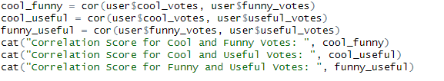

Pearson R Correlation
Notes:
Cor is R's function to Pearson R Correlation. This produces a Correlation Score between two sets of data. The closer this score to 1 or –1, the more correlated the data is, the closer to 0 the less correlated it is. Typically anything between 0 and +- 0.5 is weak, 0.5 < x < 0.7 Moderate, and Higher than 0.7 is Strong
The three values pictured towards the bottoom are the correlation scores between the three types of votes.

Slide 5
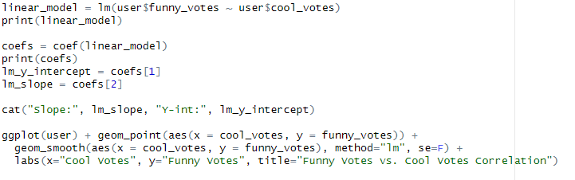
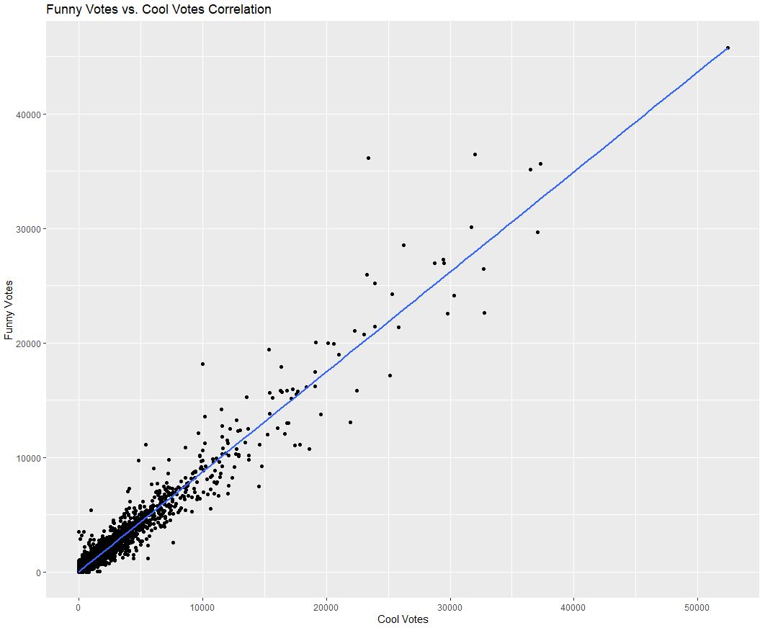
Linear Regression – Cool & Funny Votes
Notes:
Lm is R's "linear module" function. Takes two columns of data and provides the y intercept and slope of a line.
Coef function to pull out the coefficients from the lm
Assign variables to these coeffiecients
Print them
Plot using ggplot, geom_point provides a scatter plot, aes assigns x and y values. Geom_smooth provides a line graph, pass it aes to assign the values and method="lm" and se=F as we want this line to be a linear regression line

Slide 6
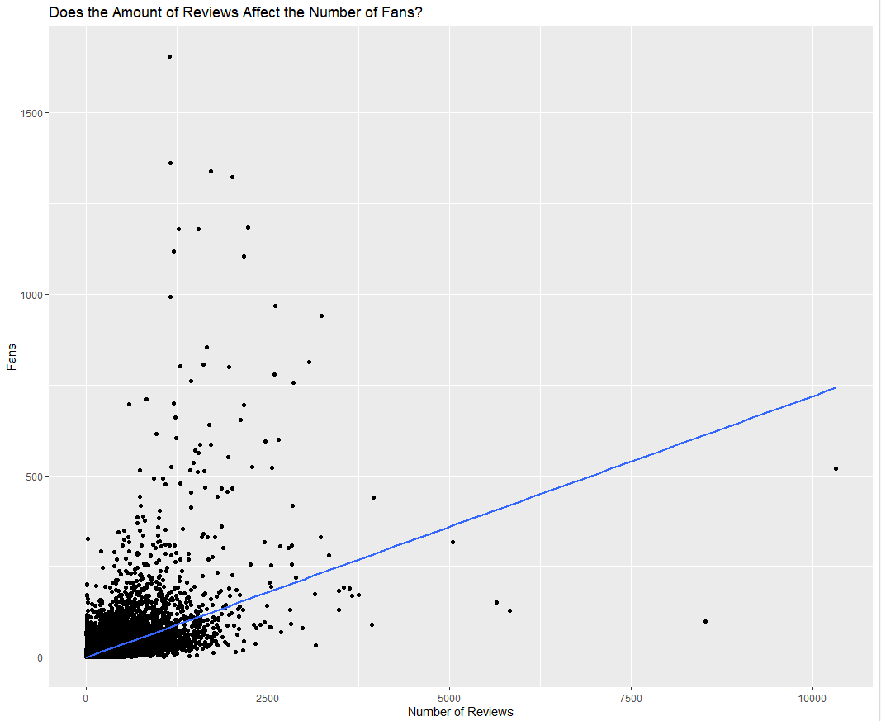
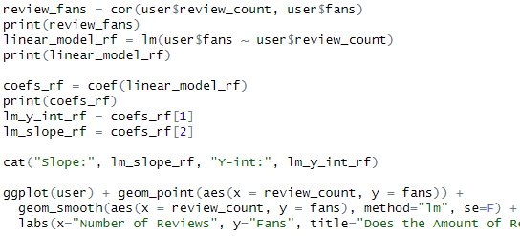
Determining if Writing Review Brings More Fans
Moderate to Strong(ish) Correlation Between Review Count and Fan Count
Notes:
Code is the same as pervious slide
Moderate Correlation between Review Count and Fan Count

Slide 7
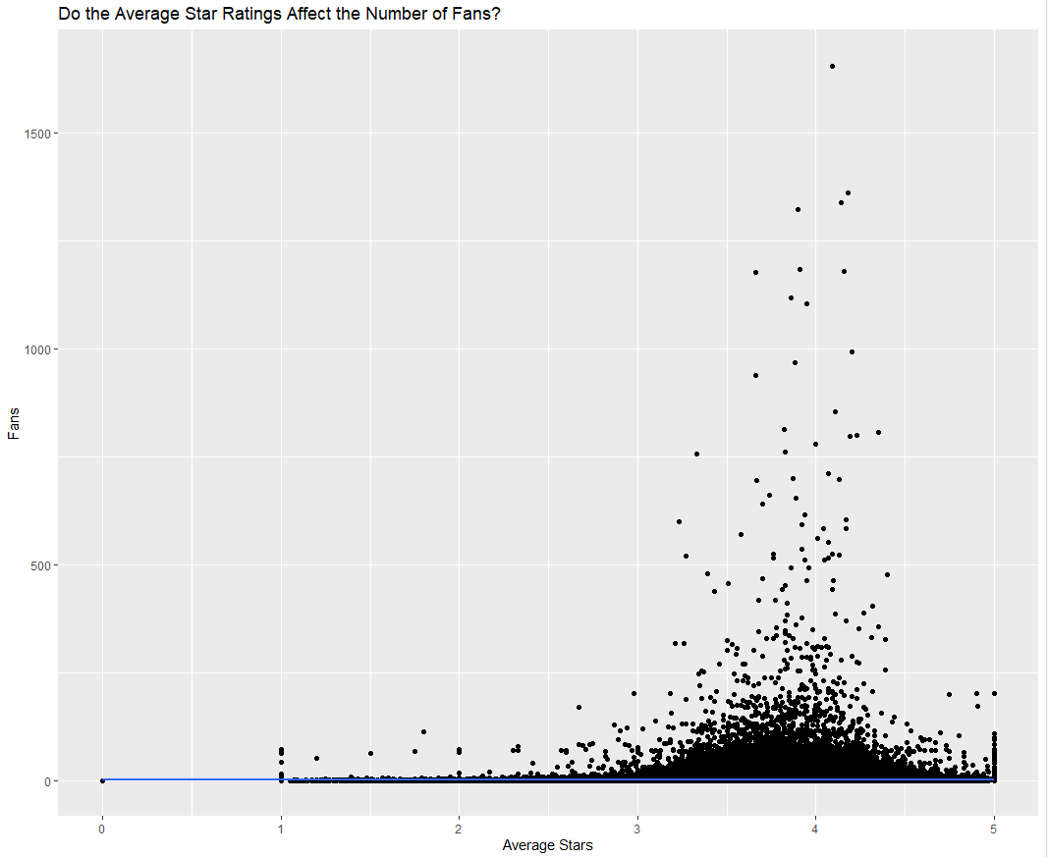
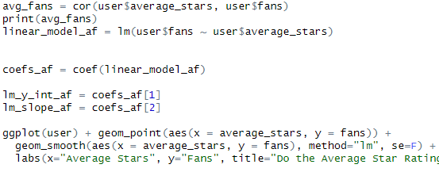
Determining if Average Star Rating Brings More Fans
Very Weak to No Correlation to Users Average Star Rating and Fan Count
Notes:
No correlation between Average Star Rating and Fan Count
Same code as previous two slides

Slide 8
What can a Yelp user do to enhance their popularity and impact on the platform?
Users Can Regularly Post on Yelp: Correlation of 0.58
Not Pay Attention to the Star Ratings When Writing Reviews: Correlation of 0.0091
Provide a Mix of Reviews to Obtain Cool, Funny, and Useful Votes
Notes:
Correlation 0.58 suggests this will help increase fan count. This will Boost popularity
Regular Posts will also help provide an impact on a user's fans as they value their ratings and will possibly make decision on locations based on their reviews.
The Average Star Rating a User provides has no correlation with Fan Count. A user should not be more generous in hopes of gaining more popularity.
Cool, Funny, and Useful Votes are all strongly correlated with scores above 0.9. Have a mixture of reviews will help a user obtain all three of these votes, and more engagement will boost their ppopularity.

